Slide 1
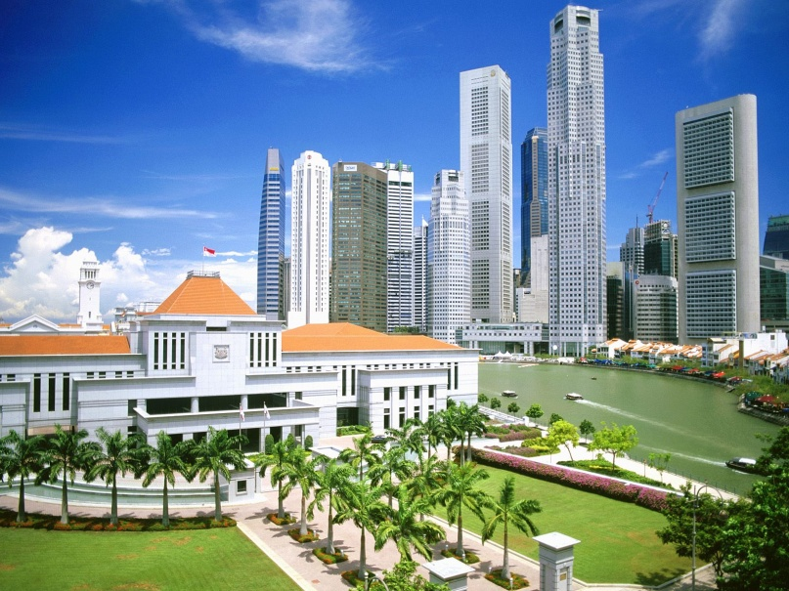
CSCI 4460
Content Management Systems

Slide 2
Instructor
Name: Leong Lee, Ph.D. (U Missouri)
Office: Maynard 214
Office Hours: Mon/Wed 9:00am-10:00am, Mon/Wed 11:10am-12:15pm, Fri 9:00am-10:00am, or by appointment
Phone: 931-221-7038
E-mail: leel@apsu.edu
Course site: D2L (main) & a secondary website

Slide 3
1-min Self Introduction
Your name
What do your friends call you? (short name)
Your major / concentration
Your short story (why are you in APSU?)
Your web building background (sites built, tools used)
When are you going to graduate from APSU?
Optional: plan after graduation

Slide 4
A show of hands
You have a notebook / laptop
You can bring a notebook / laptop to class
You bought/have the textbook
You have used
WordPress

