Slide 1
Genome organization
Lesk, Ch 2
(Lesk, 2008)

Slide 2
Genomes and proteomes
Genome of a typical bacterium comes as a single DNA molecule of about 5 million characters.
If extended, 2mm long (fit into a cell of diameter of about 0.001 mm).
DNA of higher organisms is organized into chromosomes – human cells contain 23 chromosome pairs.
Total amount of genetic information per cell is nearly constant for all members of a species, but varies widely between species.

Slide 3
Genomes and proteomes

Slide 4
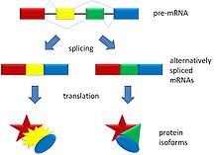
Genomes and proteomes
The relationship between DNA content and protein content is not direct.
Not all DNA codes for proteins.
Some genes exist in multiple copies.
In eukarya, many genes produce several different proteins by alternative splicing.

Slide 5
Genomes and proteomes
Therefore, the amount of protein sequence information in a cell, much less the number and pattern of different proteins expressed, cannot easily be estimated from the genome size.

Slide 7
Genes
A single gene coding for a particular protein corresponds to a sequence of nucleotides along one or more regions of a molecule of DNA.
DNA sequence is collinear with the protein sequence.
Species with double-stranded DNA, genes may appear in either strand.
Bacterial genes are continuous regions of DNA. A string of 3N nucleotides encodes a string of N amino acids or a string of N nucleotides encoding a structural RNA molecule.
Such a string equipped with annotations, form a typical entry in an archive of genetic sequences.

Slide 8
Genes
In eukarya, the nucleotide sequences that encode amino acid sequences of individual proteins are organized in a more complex manner.
One gene appears split into separated segments in the genomic DNA.
Exon: stretch of DNA retained in the mature mRNA that the ribosome translates into a protein.
Intron: intervening region between two exons.
Cellular machinery splices together the proper segments of initial RNA transcripts, based on signal sequences flanking the exons in the sequences

Slide 9
Genes
Many introns are very long (some longer than exons).
Control mechanisms may turn genes on and off, or regulate gene expression.
Many control regions of DNA lie near the segments coding for proteins. They contain signal sequences that serve as binding sites for the molecules that transcribe the DNA sequence.
Bacterial genomes contain examples of contiguous genes, coding for several proteins: operons.
Eukaryotic chromosomes contain complexes of DNA with histones. Chromatin remodeling is an mechanism of transcriptional control.

Slide 10
Genes
In animals, methylation (catalyzed by enzymes) of DNA provides the signals for tissue-specific expression of developmentally regulated genes.
Production of certain genes cause cells to commit suicide – process called apoptosis.
Conclusion: to reduce genetic data to individual coding sequences is to disguise the very complex nature of the inter-relationships among them, and to ignore the historical and integrative aspects of the genome.

Slide 11
Genes
Robbins, R.J. (1992). Challenges in human genome project. IEEE Engineering in Medicine and Biology, 11, 25-34.
“… Consider the 3.2 gigabytes of human genome as equivalent to 3.2 GB of files on the mass-storage device of some computer system of unknown design. … Reverse engineering that unknown computer system (both the hardware and the 3.2 GB of software) all the way back to the full set of design and maintain specifications. …. resulting image of the mass-storage device will not be a file-by-file copy, but rather a streaming dump of bytes… files are known to be fragmented… erased files… garbage… only a partial, and sometimes incorrect understanding of the CPU… 3.2 GB are the binary specifications… millions of maintenance revisions… spaghetti-coding… hackers… self-modifying code… and relying upon undocumented system quirks.”

Slide 12
Proteomic
An organism’s genome gives a complete but static set of specifications of the potential life of the individual.
The state of development of the organism, depends on the amounts and distribution of its proteins.
The proteome project deals with patterns of expression of proteins.
The basic goal is a spatio-temporal description of the deployment of proteins in the organism.
Some methods provides a picture of the protein-based activity of an organism, as the genome provides a complete set of potential proteins.

Slide 13
Proteomic
Amino acid sequences can be determined directly from proteins.
Protein sequence data can now being determined by translation of DNA sequences. But…
First, we must assume that it is possible correctly to identify within DNA sequences the regions that encode proteins.
Potential errors: a genuine protein sequence may be missed entirely, or an incomplete protein may be reported, or a gene may be incorrectly spliced.
Genes for different proteins may overlap.
Genes may be assembled from exons in different ways.
A protein inferred from a genome sequence is a hypothetical object until an experiment verifies its existence

Slide 14
Eavesdropping on the transmission of genetic information
How hereditary information is stored, passed on and implemented is a fundamental problem of biology.
Three types of maps are essential:
Linkage maps of genes
Banding patterns of chromosomes
DNA sequences
Mapping between the maps.

Slide 15
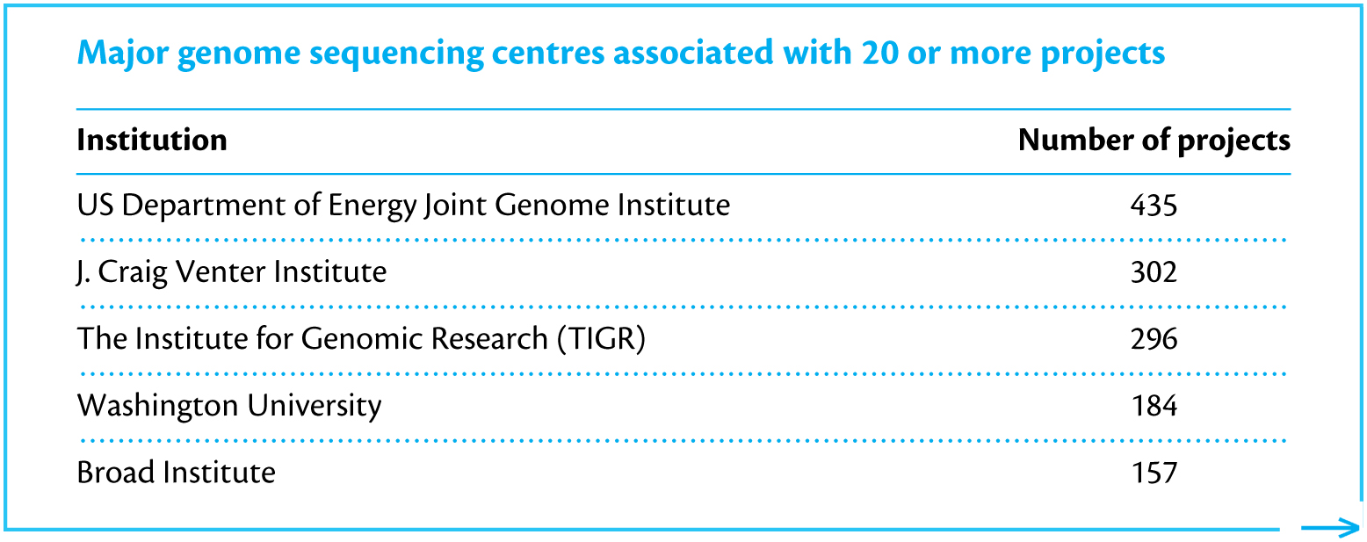
Genome sequencing projects
Active genome consortia and centres

Slide 16
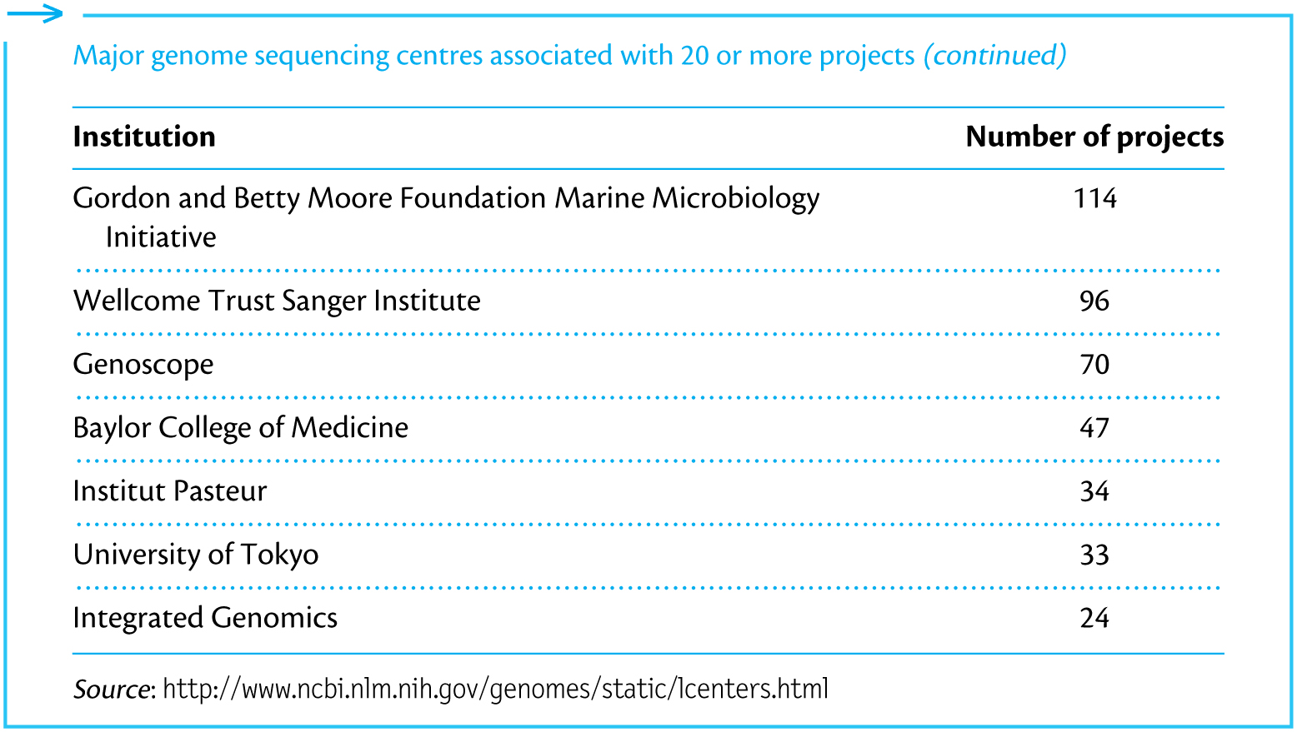
Genome sequencing projects

Slide 17
Genomes on the Web
Completely sequenced genomes: several hundred bacteria, over 20 archaea (a group of single-celled microorganisms), many viruses and organelles, and over 30 eukarya.
Almost all are freely available on the Web.
See table next slide

Slide 18
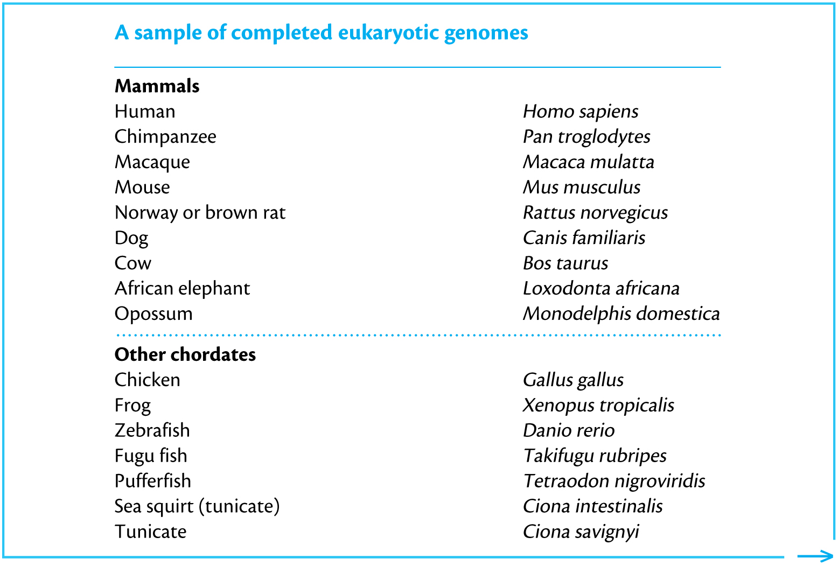
Genomes on the Web

Slide 19
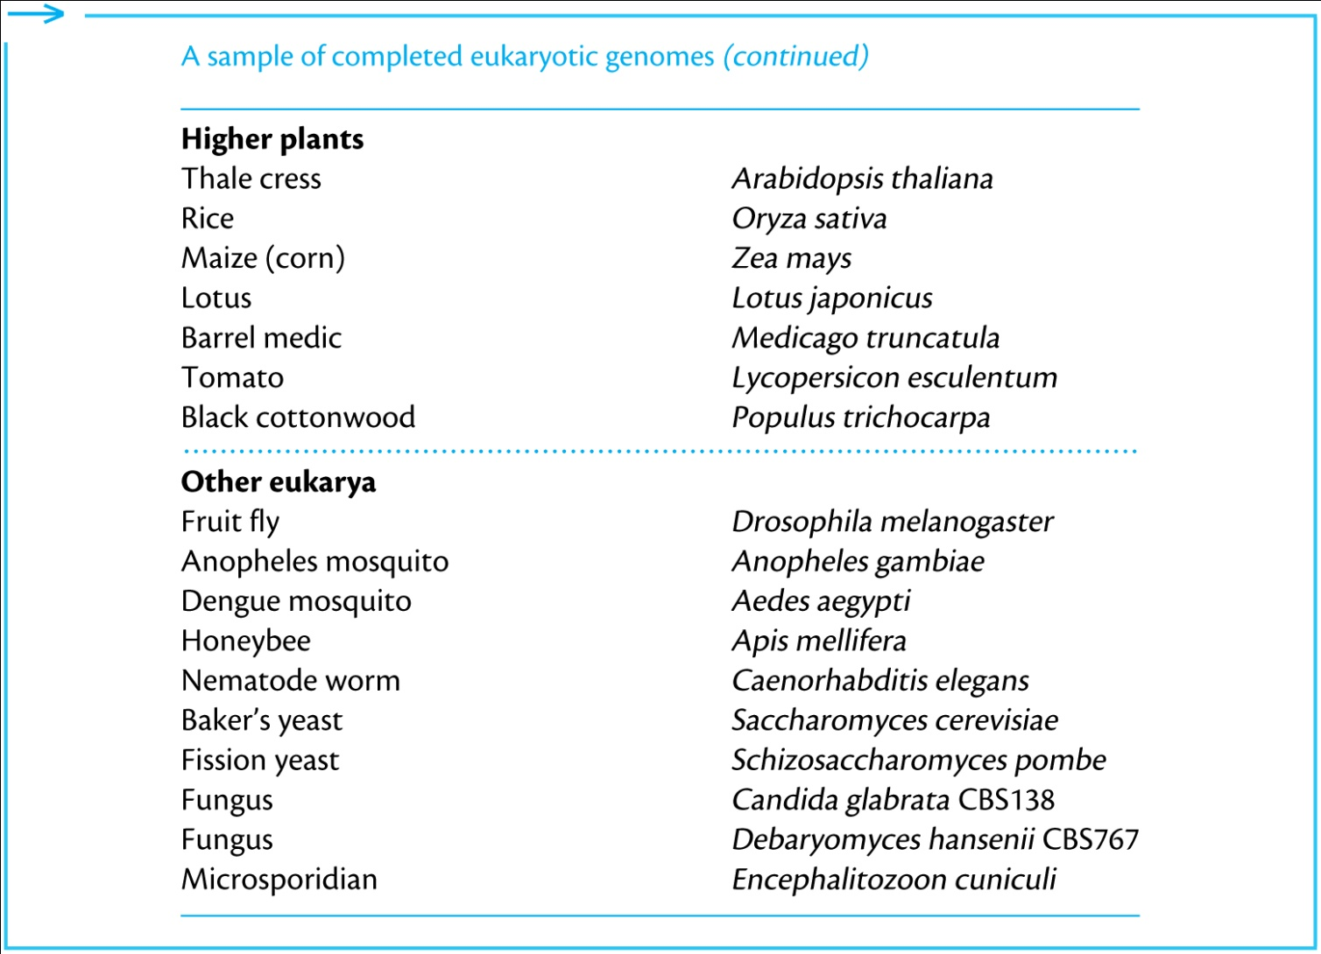
Genomes on the Web

Slide 20
Genomes on the Web
Sequencing of genomes of many other organisms is in progress.
End of slides.

